Slide 1
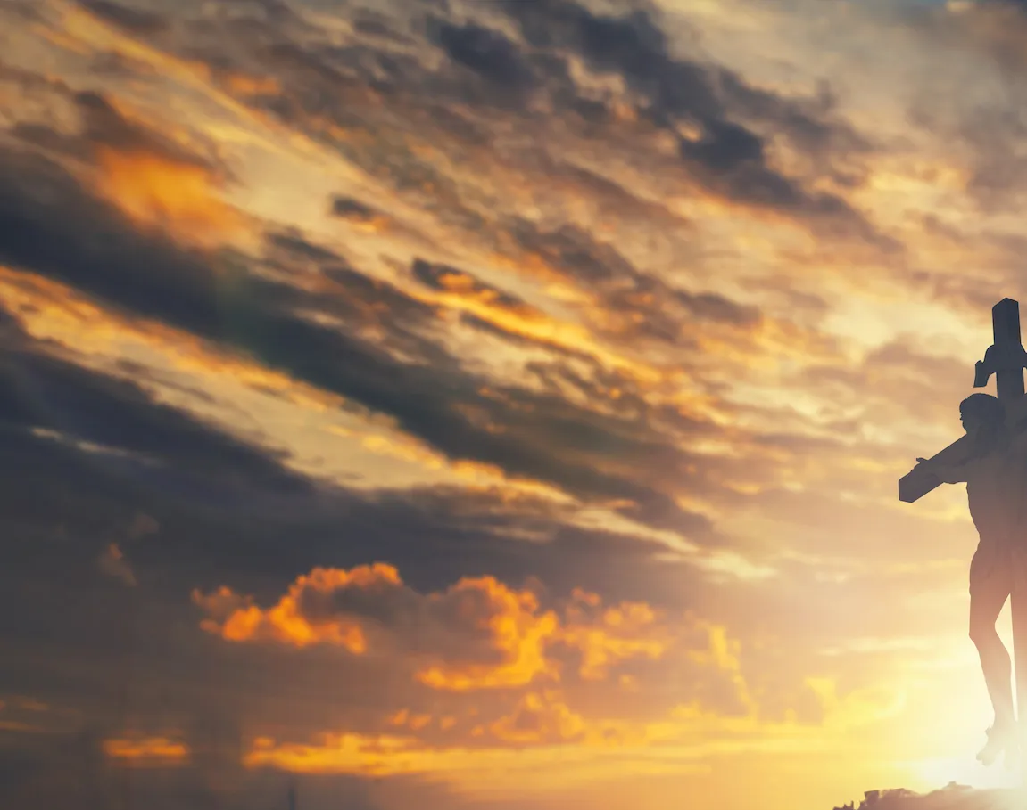
Yet Not I but Through Christ In Me

Slide 2
C F C F
C C F
What gift of grace is Jesus my redeemer
C Am G
There is no more for heaven now to give
C F
He is my joy, my righteousness, and freedom
C G C
My steadfast love, my deep and boundless peace

Slide 3
F C
To this I hold, my hope is only Jesus
F C Gsus G
For my life is wholly bound to His
C Dm C F
Oh how strange and divine, I can sing all is mine,
C G C F C F
Yet not I but through Christ in me

Slide 4
C F
The night is dark, but I am not forsaken
C Am G
For by my side, the Savior, He will stay
C F
I labor on in weakness and rejoicing
C G Csus C
For in my need, His power is displayed

Slide 5
F C
To this I hold, my Shepherd will defend me
F C Gsus G
Through the deepest valley He will lead
C Dm C F
Oh the night has been won, and I shall overcome
C G C F C F
Yet not I but through Christ in me

Slide 6
C F
No fate I dread, I know I am forgiven
C Am G
The future sure, the price it has been paid
C F
For Jesus bled and suffered for my pardon
C G Csus C
And He was raised to overthrow the grave

Slide 7
F C
To this I hold, my sin has been defeated
F C Gsus G
Jesus now and ever is my plea
C Dm C F
Oh the chains are released, I can sing I am free
C G C F C F
Yet not I but through Christ in me

Slide 8
C F
With every breath I long to follow Jesus
C Am G
For He has said that He will bring me home
C F
And day by day I know He will renew me
C G Csus C
Until I stand with joy before the throne

Slide 9
F C
To this I hold, my hope is only Jesus
F C Gsus G
All the glory evermore to Him
C Dm C F
When the race is complete, still my lips shall repeat
C G C
Yet not I but through Christ in me
REPEAT

Slide 10
C Dm C F
When the race is complete, still my lips shall repeat
C G Am F
Yet not I but through Christ in me
C G Am F
Yet not I but through Christ in me
C G C F C F
Yet not I but through Christ in me
END

